Slide 1
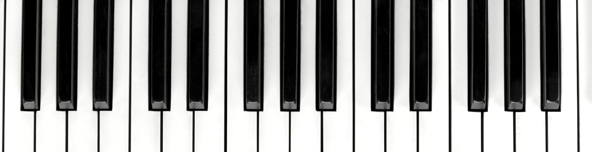
Generating Music using a LTSM Neural Network
Rachel Nelson
Bellevue University

Slide 2

Goal
Create DRM-Free music that anyone could use for streaming/playing

Slide 3
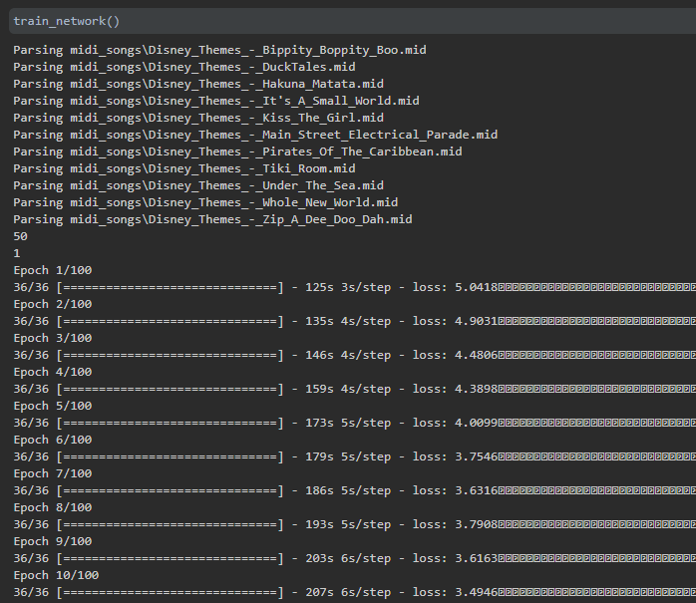
Method
Generate 100 notes (piano)
Recurrent neural networks
Generate sequence data to sequences of musical notes
Packages Used
LSTM Neural Network in Keras
Music21
Numpy
Pandas
Glob
Pickle
Notes:
The pickle module implements binary protocols for serializing and de-serializing a Python object structure.

Slide 4
Music Used to Create Models
Bippity-Boppity-Boo (from Cinderella)
DuckTales Theme Song
Hakuna Matata (from Lion King)
It’s A Small World (from Disneyland)
Kill The Girl (from The Little Mermaid)
Main Street Electrical Parade (from Disneyland)
Pirates of the Caribbean (from Disneyland)
Tiki Room (from Disneyland)
Under the Sea (from the Little Mermaid)
Whole New World (from Aladdin)
Zip A Dee Doo Dah (from Disneyland)

Slide 5
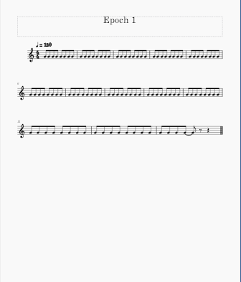
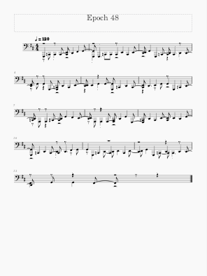
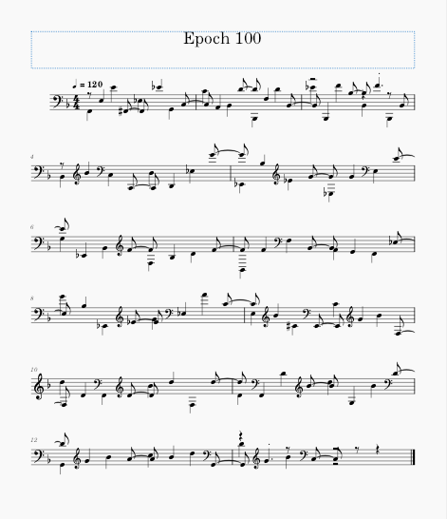
The Differences each Epoch Makes
Notes:
An epoch means training the neural network with all the training data for one cycle. In an epoch, we use all of the data exactly once. A forward pass and a backward pass together are counted as one pass: An epoch is made up of one or more batches, where we use a part of the dataset to train the neural network.
The first epoch produced a single note repeated at different frequencies. Each epoch increased the variance of notes in the generated music. The number of epochs is the number of complete passes through the training dataset. Each epoch produced a model that could then be used to generate new music. I found that epochs in the mid-range (40-60), provided small jingles of repeated notes, some of them being quite catchy, while at the end of the range (80+) provided more variance to the music.

Slide 6
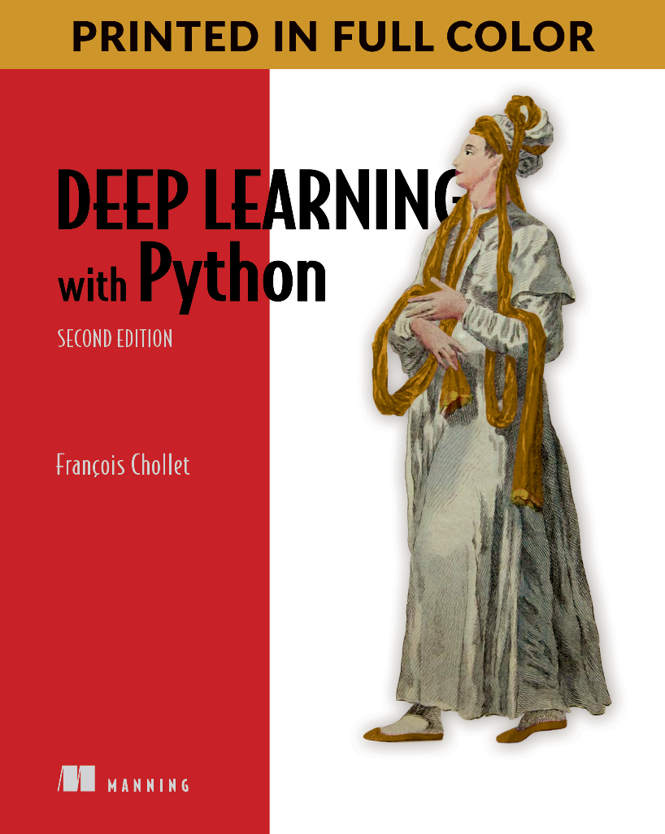
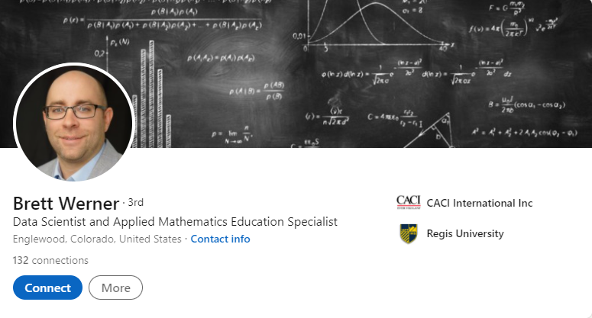
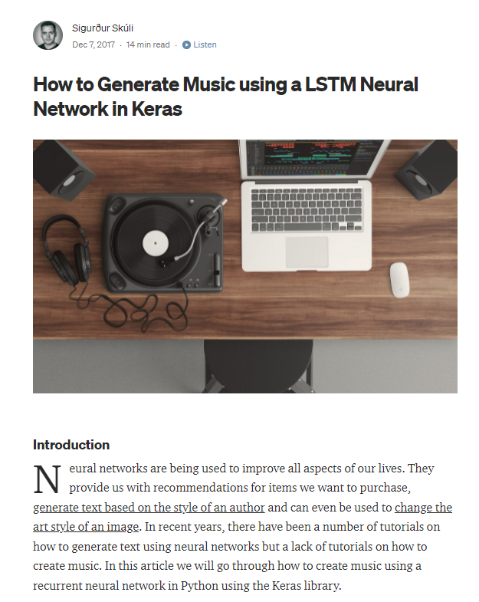

Acknowledgements
Notes:
https://towardsdatascience.com/

Slide 7
Github
https://github.com/RachelONelson/MusicGenerationLSTM

